Slide 1
Pura Case Study
Joshua Dunn – Data Analyst – 10/15/24

Slide 2
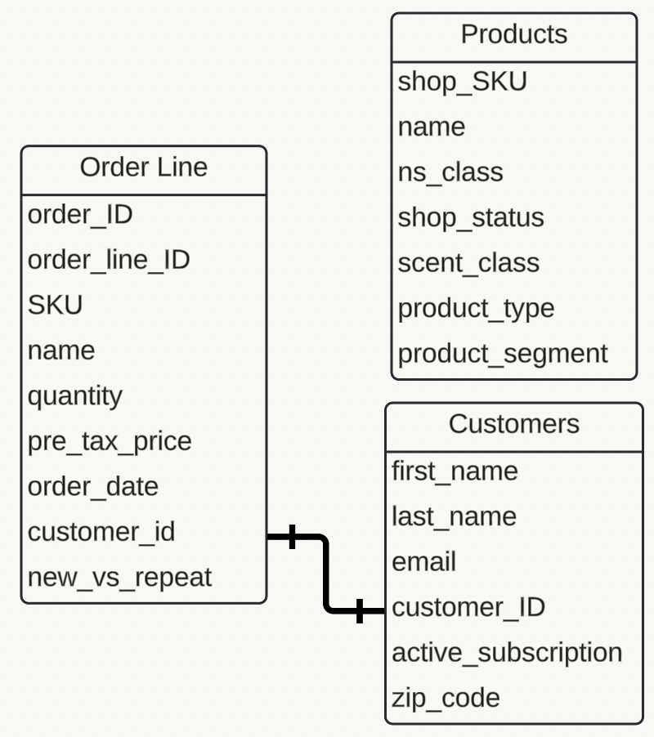

Business Goals Overview
Goals of the Business
Grow customer count
Increase revenue
Improve contribution margin
Data Used for Study
Notes:
When analyzing the data for this presentation, I prioritized the business goals throughout my work.
As a result, I made sure to highlight these objectives as the first thing the viewer sees in the presentation.
The goals of the business are to grow customer count, revenue, and contribution margin.
On the right hand side, are the data used for the study. The table names are Order Line, Products, and Customers

Slide 3
Promotions - Summarized
Promotion | Examples | Insights
Subscription-based Promotions | Grapefruit Subscription Red Currant Subscription | Provide consistent and relatively predictable revenue streams.
Free Product Offers | Free Diffuser Set Free Gift | Boost customer acquisition numbers but require follow-up.
Bundled Product Promotions | Build Your Home Set Anthropologie Set | Allow customers to buy in bulk, leading to higher average order values.
Seasonal or Thematic Promotions | Mickey Christmas Cozy Cabin Jack the Pumpkin King | Lead to short-term sales spikes, and long term revenue impact.
Notes:
This table highlights various promotions run by Pura, includes examples, and offers insights into each promotion's effectiveness.
- Subscription-based Promotions:
- Insight: Provide consistent and relatively predictable revenue streams.
- Free Product Offers:
- Insight: Boost customer acquisition numbers but require follow-up.
- Bundled Product Promotions:
- Insight: Allow customers to buy in bulk, leading to higher average order values.
- Seasonal or Thematic Promotions:
- Insight: Lead to short-term sales spikes, with potential for long-term revenue impact.

Slide 4
Recommendations
Subscription-based Promotions
Increase Revenue
The 3-month subscription generates significantly higher revenue per order than the 1 and 2 month subscriptions
Focus on promoting the 3 Month Subscription, as it provides the highest AOV, potentially offering better long-term value and customer retention.
Reevaluate the 2 Month Subscription, as it underperforms in both total revenue and AOV. Consider bundling offers or marketing efforts to boost its appeal.
Free Product Offers
Grow Customer Count
Currently, only 19% of new customers receive free products, yet these promotions are a proven way to drive customer acquisition.
By expanding free product offers to a larger percentage of new customers, the company could potentially boost customer conversion rates.
Subscription Type | Total Revenue | Total Orders | AOV
1 Month Subscription | $ 3,149 | 204 | $ 15.70
2 Month Subscription | $ 421 | 32 | $ 12.84
3 Month Subscription | $ 769 | 42 | $ 16.65
Notes:
Subscription-based Promotions:
The 3-month subscription should be the focus of marketing efforts due to its superior performance in generating revenue and higher AOV. This makes it a better option for customer retention and lifetime value.
The 2-month subscription has underperformed both in terms of revenue and AOV, signaling a need for either reevaluation or repositioning. Potential strategies include bundling with other offers or increasing marketing efforts to enhance its appeal.
It's essential to drive customers towards longer subscription plans as they offer more stable revenue streams and enhance customer loyalty.
Free Product Offers:
Despite being a proven tactic for customer acquisition, only 19% of new customers are currently receiving free products. There's an opportunity to scale this up, which could significantly improve customer conversion rates and acquisition.
Consider expanding free product promotions, especially as part of onboarding or trial offers, to increase customer engagement and long-term retention.
I explored several approaches to quantify customer acquisition cost (CAC), but with the data I had, I wasn’t able to provide a fully accurate analysis for the executive team. I would love to continue analyzing Pura’s data to explore CAC further and better understand the cost/benefit of free product offers.

Slide 5
Recommendations
Seasonal Promotions
Grow contribution margin
Continue running seasonal promotions, but reevaluate marketing strategies during holiday seasons.
Pura should consider running seasonal promotions during each month of the year, not just October, November and December
Bundled Product Promotions
Increase Revenue
Emphasize bundled promotions to boost average order value (AOV) compared to individual product purchases.
This increase in AOV will lead to overall revenue growth.
Product Type | AOV
Bundled | $ 42.61
Individual | $ 36.82
Notes:
Seasonal Promotions:
Continue running seasonal promotions, but reevaluate the effectiveness of marketing strategies during the holiday season.
Consider expanding seasonal promotions throughout the entire year, not just focusing on October, November, and December.
Current sales data shows a significant spike in seasonal scents sold in October, with limited activity in other months.
Bundled Product Promotions:
Emphasize bundled product promotions to increase Average Order Value (AOV), which is higher for bundles ($42.61) compared to individual product purchases ($36.82).
The increased AOV from bundled promotions will contribute to overall revenue growth.
January, February - Valentines themed scents:
- "Rose" - A classic floral scent
- "Strawberry champagne" - Sweet, and fruity, with a celebratory feel
Spring: "April Showers" Crisp, clean, and refreshing scent
- "May Flowers" - Specifically smelling like cherry blossoms
Summer Scents: "Ocean Breeze" - Crisp, aquatic, and fresh.
"Watermelon" - Sweet, Juicy, and Refreshing

Slide 6
Best Performing SKUs
SKUs by Weighted Score Performance
SKUs by Contribution Margin
Notes:
On the On the left-hand side, the graph displays the best-performing SKUs, ranked using a weighted score.
I calculated this score by factoring in revenue, quantity purchased, and repeat customer count, giving more weight to revenue and repeat customers while assigning less importance to quantity purchased
Specifically, the weights are: 40% for revenue, 20% for quantity, and 40% for repeat customers.
This approach was designed to align with Pura’s business goals of growing customer count, revenue, and contribution margin.
On the right hand side, I ran an analysis on the profit margin on each of the SKUs.
- Many of the best-selling SKUs by contribution margin are either gift boxes or sets.
- Bundles and sets logically generate more revenue as they are sold for a higher price.
- Assuming that each SKU costs Pura $4, higher-priced items will naturally have a higher contribution margin.
- Further analysis is needed to understand the actual cost difference for Pura in selling a bundle or set versus individual SKUs.
- I would love to dive into more data and understand whether or not each SKU is actually costing Pura only $4.
If this project were part of my responsibilities in this role, I would love to analyze the 5 and 10-year performance of SKUs to identify which ones have consistently performed best over time.
The Met Gift Box 900-01804
Best Sellers Set 900-00752
The Met Greek & Roman Set - White Diffuser 900-01208
Ocean Mist & Sea Salt KDRH
NEST New York Set 900-00930
Pineapple Cilantro PNCH
Vanilla Fleur BVMH
Best Sellers Set 900-00888
Fresh Best Sellers Set 900-01025
Anthropologie Set 900-00857
Outdoorsy Set 900-01181
Outdoorsy Set 900-01026
Disney Princess Set 900-01132
Velvet Pear RHWH
Fir & Grapefruit AJPH
Aim to Teas ATT
1DB Smart Fragrance Diffuser, MZX

Slide 7
End-of-Life SKUs
SKUs with Profit < $4
10 SKUs to End-of--Life
SKU | Name | Total Revenue | Total Cost | Profit
900-02095 | Best of Winter Scent Sample Booklet | 8.5 | $ 156.00 | $ (147.50)
900-00929 | Scent Sample Booklet | 0 | $ 100.00 | $ (100.00)
900-01679 | Best Sellers Sample Booklet | 0 | $ 92.00 | $ (92.00)
900-00907 | Complimentary Scent Sample Booklet | 0 | $ 72.00 | $ (72.00)
440-00136 | Best Sellers Sample Booklet | 0 | $ 56.00 | $ (56.00)
900-00761 | Free Pura 4 Offer | 0 | $ 56.00 | $ (56.00)
900-02404 | Free Subscriber Loyalty Cozy Home Set | 0 | $ 44.00 | $ (44.00)
900-00761 | Free Pura 4 | 0 | $ 32.00 | $ (32.00)
900-02405 | Free Subscriber Loyalty Nature Home Set | 0 | $ 28.00 | $ (28.00)
10-1DB-09 | Pura 3 Diffuser | 22.5 | $ 48.00 | $ (25.50)
900-01247 | The Met Scent Sample Booklet | 0 | $ 24.00 | $ (24.00)
900-00942 | Fairway Morning | 0 | $ 16.00 | $ (16.00)
900-01245 | Perfume Immortelle Scent Sample Card | 0 | $ 16.00 | $ (16.00)
900-00941 | Ivory Woods | 0 | $ 12.00 | $ (12.00)
900-01058 | Free Gift | 0 | $ 12.00 | $ (12.00)
900-02525 | Free Subscriber Loyalty Nature Home Set | 0 | $ 12.00 | $ (12.00)
900-00945 | Cucumber & Mint | 0 | $ 8.00 | $ (8.00)
900-00946 | Teak & Leather | 0 | $ 8.00 | $ (8.00)
900-00947 | White Tea No. 1 | 0 | $ 8.00 | $ (8.00)
900-01241 | Blue Water Lotus Scent Sample Card | 0 | $ 8.00 | $ (8.00)
900-01242 | Egyptian Sandalwood Scent Sample Card | 0 | $ 8.00 | $ (8.00)
900-01243 | Spiced Woods Scent Sample Card | 0 | $ 8.00 | $ (8.00)
900-01244 | Bamboo Forest Scent Sample Card | 0 | $ 8.00 | $ (8.00)
900-00907 | Scent Sample Booklet | 59.3 | $ 64.00 | $ (4.70)
NGL | Simply Lavender Subscription (Ships every 1 Months) | 11.45 | $ 16.00 | $ (4.55)
10-1DB-09 | Pura 3 Offer | 0 | $ 4.00 | $ (4.00)
900-00944 | Coastal Palm | 0 | $ 4.00 | $ (4.00)
900-01090 | Smart Fragrance Diffuser Set | 0 | $ 4.00 | $ (4.00)
900-01246 | Terracotta Rose Scent Sample Card | 0 | $ 4.00 | $ (4.00)
900-02478 | Free Subscriber Loyalty Home Set | 0 | $ 4.00 | $ (4.00)
ATTH | Aim to Teas | 0 | $ 4.00 | $ (4.00)
CLN | Clean Crisp White | 0 | $ 4.00 | $ (4.00)
HBCH | Beach Cottage | 0 | $ 4.00 | $ (4.00)
PCH | PCH | 0 | $ 4.00 | $ (4.00)
SKU | Name
900-00942 | Fairway Morning
900-00941 | Ivory Woods
900-00945 | Cucumber & Mint
900-00946 | Teak & Leather
900-00947 | White Tea No. 1
900-00944 | Coastal Palm
ATTH | Aim to Teas
CLN | Clean Crisp White
HBCH | Beach Cottage
PCH | PCH
Notes:
36 SKUs had a net profit of less than -$4.
Not all of these SKUs failed to generate value for the company.
Some SKUs, like "Free Pura 4 offer" and "Complimentary Scent Sample Booklet," offer intangible benefits beyond immediate revenue.
These free offers help in building customer loyalty by enhancing their experience and making them feel valued.
Such promotions can lead to increased brand awareness and product familiarity, driving long-term customer retention.
Although these SKUs may show a short-term loss, their strategic role in fostering customer engagement and loyalty is invaluable for long-term business success.
Pura should discontinue the following 10 SKUs.
Instead of selecting the 10 worst-performing SKUs, I excluded sample cards, booklets, and free promotions, as these items likely contribute to long-term revenue growth.
Individual scents do not generate a profit and offer minimal value.
Pura should consider transforming these unprofitable scents into sample booklets, packages, or cards.
This strategy will help eliminate low-performing SKUs, streamline resources, reduce costs, and support customer base expansion.

Slide 8
Most Valuable customers
Active vs. Non-active subscribers
Active Subscriber | Average Order Value | Total Revenue | Total Orders | Total Customers
TRUE | $16.02 | $36,021.10 | 2,363 | 996
FALSE | $16.97 | $ 44,398.09 | 2,688 | 1,147
RFM Analysis
Name | Surname | RFM Score
Lillian | North | 0.958
Stephanie | Vaughan | 0.882
Rose | McLean | 0.822
Ryan | Wallace | 0.816
Steven | Ferguson | 0.758
Cameron | Ellis | 0.756
Elizabeth | Howard | 0.749
Courtney | Owen | 0.732
Eric | Allan | 0.708
Jesse | Rees | 0.707
Teresa | James | 0.706
Colin | Manning | 0.706
Customer Score
Notes:
Top left: Non-active subscribers contribute significantly more in total revenue, orders, and customer count compared to active subscribers. Despite being labeled as "non-active," these customers are making more purchases and generating higher revenue overall. Pura should consider implementing rewards or incentives for active subscribers to encourage them to buy more products more frequently.
Bottom Left: you will see a graph labeled as customer score This score was generated by looking at a number of factors including total orders, total revenue, average order value, and whether or not customers were an active subscriber to Pura. Based on the analysis I ran, Lillian North received the highest score.
Right: For the RFM analysis, I ran a query that assigned a 20% weight to the recency of the orders.
Next, I evaluated the total quantity of items purchased, giving it a 40% weight,
And finally, I calculated the total money spent by each customer, also weighted at 40%.
This approach ensures that customers who purchase products more frequently receive a higher score than those who have made fewer purchases.
- Pura should consider implementing a rewards program for their top customers to encourage continued engagement and loyalty.
- Conducting a survey for these top customers would help gather insights on their purchasing habits and characteristics, allowing for better targeting and improved product-market focus.
- These actions could lead to an increase in customer count and overall revenue growth.
I also looked at customers based on their zip codes. Tried to define trends
- I conducted an analysis of orders by zip code, categorizing them by state.
- Utah led the dataset with 28 total orders, followed by Tennessee and Mississippi.
- However, 92 orders had no zip code attached, indicating missing or incomplete data.
- Zip codes are valuable for identifying target customers and optimizing marketing strategies.
- If Pura ensures that a zip code is attached to every order, it could enhance marketing efforts in specific regions, potentially boosting both revenue and customer count.
ZIP Orders State
0 92 NA
84043 7 UT
84062 5 UT
37128 5 TN
35226 5 AL
85204 4 AZ
84045 4 UT
84020 4 UT
84005 4 UT
84003 4 UT
State Total Orders
UT 28
TN 13
MS 8
TX 8
AL 5
AL 4
SC 4
OH 4
AZ 4

Slide 9
Strategic Summary + Next Steps
Focus on Bundled Product Promotions to boost Average Order Value (AOV) and increase overall revenue.
Expand Free Product Offers to a larger portion of new customers to increase conversion rates and grow customer count.
Rethink subscription offerings, focusing on optimizing the most profitable subscription models, such as the 3-month plan.
Consider discontinuing underperforming SKUs, such as “Coastal Palm” and “Ivory Woods,” as they show no profit and negatively impact contribution margin.
Consider rewarding their top customers to ensure they remain engaged and continue providing value to the company.
Survey top customers to better understand their purchasing habits and characteristics, to develop other customer offerings.
Add seasonal promotions for spring and summer months.
Notes:
Bundled Product Promotions:
Bundles or sets can drive higher Average Order Value (AOV) as customers are more likely to purchase multiple items at once. Focusing marketing efforts on promoting these bundles can lead to an increase in both AOV and overall revenue.
Free Product Offers:
Currently, only a small percentage of new customers receive free products. By expanding these offers, Pura can potentially improve conversion rates for first-time buyers, turning them into loyal, repeat customers. This would directly contribute to growing the customer base.
Subscription Offerings:
Subscription models need to be optimized. The 3-month subscription shows higher profitability, so it might be beneficial to focus on promoting this model. On the other hand, low-performing subscription plans, like the 2-month subscription, should be reassessed or bundled with other offers to increase their value.
Discontinuing Underperforming SKUs:
Coastal Palm and Ivory Woods are examples of SKUs that do not generate profit and negatively affect contribution margins. Discontinuing underperforming SKUs would free up resources and focus on more successful products, improving overall profitability.
Rewards for Top Customers:
Engaging top customers through a rewards program can strengthen their loyalty and encourage them to buy more frequently. These top customers are already valuable, so providing incentives would help ensure they continue to contribute positively to the company's growth.
Customer Insights via Surveys:
Conducting surveys with top customers will offer insights into their purchasing behavior and preferences. Understanding these characteristics will help Pura tailor its offerings, create more targeted marketing strategies, and develop new products that cater to the needs of the most valuable customers.
Seasonal Promotions:
Introducing seasonal scents and promotions for spring and summer will help keep the product line fresh and engaging, while capitalizing on seasonal buying patterns. This can boost both short-term sales and long-term customer engagement.

Slide 10
Questions

